Slide 1

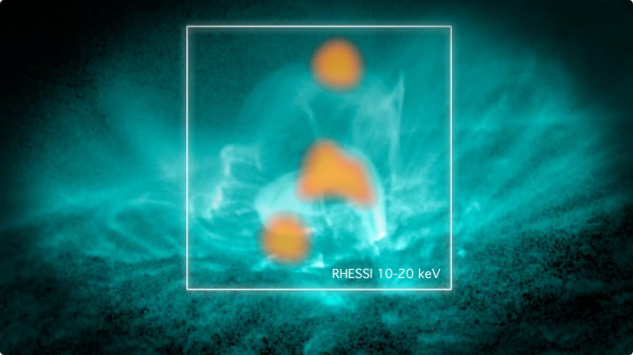
Solaris
Magnetic reconnection is a fundamental process in plasma physics and astrophysics, where the magnetic field lines in a plasma break and then reconnect in a different configuration. This process releases stored magnetic energy, converting it into kinetic and thermal energy, leading to various dynamic and energetic phenomena, such as solar flares, geomagnetic storms, and particle acceleration.
by Cybernauts

Slide 2
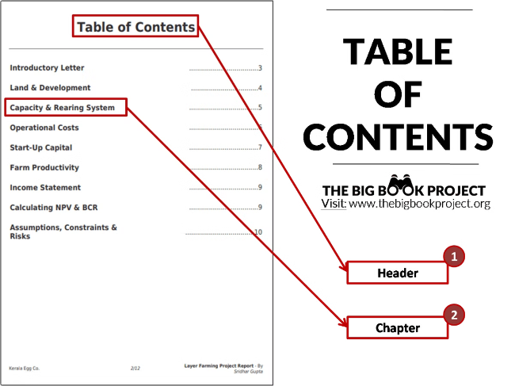
Table of Contents
1
About the Problem
Explore the phenomenon of magnetic reconnection and its significance in plasma physics and astrophysics.
2
Our Approach
Outline the steps taken to investigate and understand the dynamics of magnetic reconnection.
3
Objectives
Define the key objectives and goals of the study on magnetic reconnection.
4
Solution
Present the proposed solution and its potential impact on the field of plasma physics and astrophysics.

Slide 3


Introduction to Magnetic Reconnection
Magnetic reconnection is a fundamental process in plasma physics and astrophysics that occurs when the magnetic field lines in a plasma (a hot, ionized gas composed of charged particles) break and then reconnect in a different configuration. During this process, magnetic energy is converted into kinetic energy and thermal energy, leading to various dynamic and energetic phenomena in the universe.

Slide 4

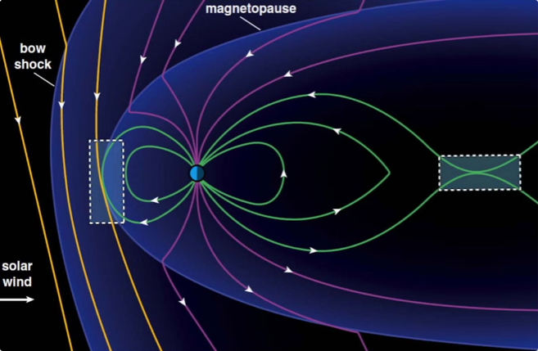
The Phenomenon of Magnetic Reconnection
1
Magnetic Field Lines Break
The magnetic field lines in a plasma can break due to various instabilities or external forces, forming an X-point where the field lines converge.
2
Magnetic Field Lines Twist and Reconnect
The broken field lines then twist and reconnect in a different configuration, releasing the stored magnetic energy in the process.
3
Energy Release and Plasma Dynamics
The release of magnetic energy drives various plasma phenomena, such as particle acceleration, plasma heating, and the generation of electric currents and electromagnetic radiation.

Slide 5

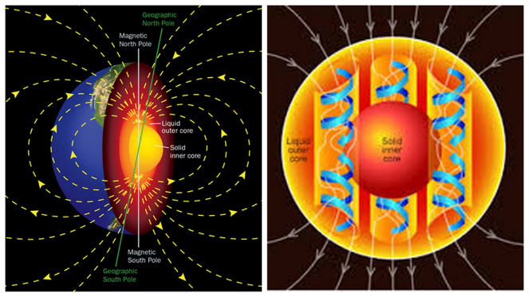
Effects of Magnetic Reconnection
Geomagnetic Storms
Magnetic reconnection in the Earth's magnetosphere can lead to geomagnetic storms, which can disrupt satellite operations, communication systems, and power grids.
Particle Acceleration
Magnetic reconnection can accelerate charged particles to high energies, contributing to the production of cosmic rays and the emission of high-energy radiation.
Auroras
The acceleration of charged particles during magnetic reconnection can also lead to the creation of spectacular auroras in the Earth's upper atmosphere.
Magnetotail Dynamics
Magnetic reconnection in the Earth's magnetotail can drive complex dynamics and energy release processes, influencing the near-Earth space environment.

Slide 6

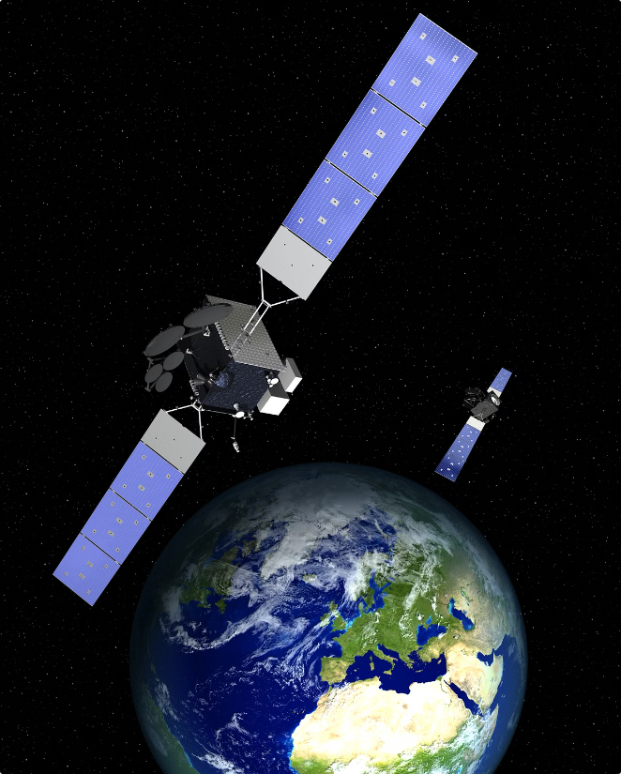
Recent Magnetic Reconnection Events
1
2006 GPS Satellite Disruption
A geomagnetic storm in 2006 disabled several satellites in the Global Positioning System (GPS) constellation, highlighting the impact of magnetic reconnection on space-based technologies.
2
2013 ISS Communication Outage
In 2013, a geomagnetic storm caused a communications outage on the International Space Station, demonstrating the disruptions magnetic reconnection can have on space operations.
3
2020 Starlink Satellite Power Outage
A geomagnetic storm in 2020 caused a power outage on a SpaceX Starlink satellite, underscoring the need to understand and mitigate the effects of magnetic reconnection on modern space infrastructure.

Slide 7
Our Approach to the Problem
Data Exploration
Feature Engineering
Modeling and Prediction
Gather and analyze data from various space missions, such as ACE, WIND, and DSCOVR, to understand the behavior of the interplanetary magnetic field (IMF) and its components.
Clean and preprocess the data, perform normalization, and extract relevant features, such as the magnitude of the IMF vector and its time derivatives, to capture the dynamics of magnetic reconnection.
Implement advanced machine learning models to predict the occurrence of magnetic reconnection events, leveraging the extracted features and exploring hybrid approaches for improved accuracy.

Slide 8






Data Exploration and Understanding
Data Collection
Gather data from ACE, WIND, and DSCOVR missions regarding the IMF vector components (X, Y, Z).
Data Understanding
Observe and understand the physical meanings and typical ranges of the IMF measurements.
Data Cleaning
Ensure the data is free of missing or erroneous values to prepare it for further analysis.
Data Normalization
Normalize the data to address potential variance in magnitude among the IMF components.

Slide 9

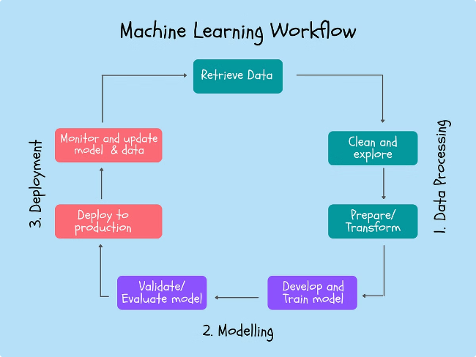



Feature Engineering and Modeling
Segmentation
Divide the data into time segments for which we want to predict magnetic reconnection events.
Feature Definition
Apart from the X, Y, Z components of the IMF, compute additional features like the magnitude of the vector and its time derivatives.
Model Implementation
Implement advanced machine learning models to predict the occurrence of magnetic reconnection events, exploring hybrid approaches for improved accuracy.

Slide 10
Conclusion
In this presentation, we have explored the fundamental process of magnetic reconnection and its importance in plasma physics and astrophysics. We have discussed the various effects of magnetic reconnection, such as geomagnetic storms, particle acceleration, and auroras, and how recent events have highlighted the need to understand and mitigate its impacts. Our approach to the problem involves in-depth data exploration, feature engineering, and the implementation of advanced machine learning models to predict the occurrence of magnetic reconnection events. By leveraging this knowledge and the proposed solutions, we aim to advance our understanding of this critical process and its applications in the field of space science and technology.

